Slide 1
CST2550 - 2025
Software Engineering and Management
Week 6: Implementing Database in C# Applications
Ahmed Eissa
a.eissa@mdx.ac.uk

Slide 2
Learning Objectives
Master database connectivity in C#.
Understand ORM concepts.
Implement CRUD operations using Entity Framework Core.

Slide 3
1. ADO.NET Overview

Slide 4
Connection Management
1. Connection Management
  Connection Strings
  Define how applications connect to databases
  Syntax example:
    string connectionString = "Server=server_name;Database=database_name;User Id=username;Password=password;";
2. Connection Pooling
  Reuses existing connections to optimise performance.
  Benefits include reduced overhead and faster execution.

Slide 5
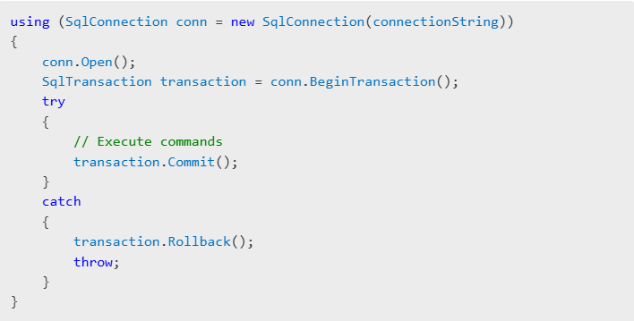
Connection Management
3. Transaction Handling
  Ensures data integrity across multiple operations.
  Example:

Slide 6
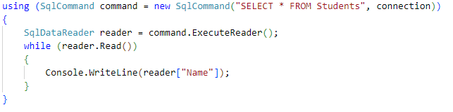
Data Access Patterns
1. Connected Architecture
  Keeps the connection open during operations.
  Example:

Slide 7

Data Access Patterns
2. Disconnected Architecture
  Uses “DataSet” or “DataTable” to work with data offline.
  Example:
3. Best Practices
  Use using statements to manage resources.
  Avoid hardcoding connection strings; use configuration files.

Slide 8
2. Entity Framework Core

Slide 9
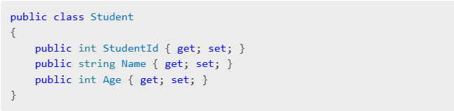
Code-First Approach
1. Entity Class Design
  Define classes that map to database tables.
  Example:

Slide 10
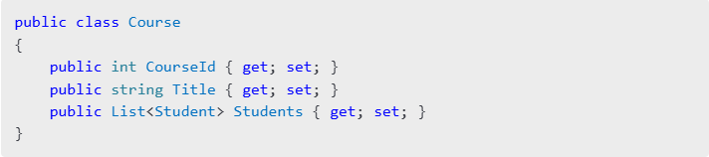
Code-First Approach
2. Relationships Mapping
  Configure one-to-one, one-to-many, and many-to-many relationships.
  Example:

Slide 11
Code-First Approach
3. Migrations Management
  Use migrations to update the database schema.
  Commands:

Slide 12
Database-First Approach
Overview:
  Generate C# classes and context based on an existing database schema.
  Suitable for applications with pre-existing databases.
Implementation Steps:
  Use the “Scaffold-DbContext” command:
dotnet ef dbcontext scaffold "Your_Connection_String" Microsoft.EntityFrameworkCore.SqlServer
Key Differences:
  Code-First: Focuses on creating the database from code.
  Database-First: Starts with an existing database and generates corresponding code.
Use Cases:
  Code-First is ideal for greenfield projects.
  Database-First is best for legacy systems or when integrating with existing databases.

Slide 13


LINQ to Entities
Query Syntax
  Example:
Method Syntax
  Example:
Performance Considerations
  Use “AsNoTracking()” for read-only queries.
  Minimise the number of database calls.

Slide 14
Practical Examples

Slide 15
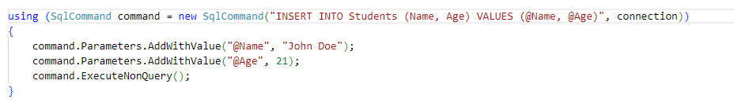
Example 1: Inserting data using ADO.NET

Slide 16
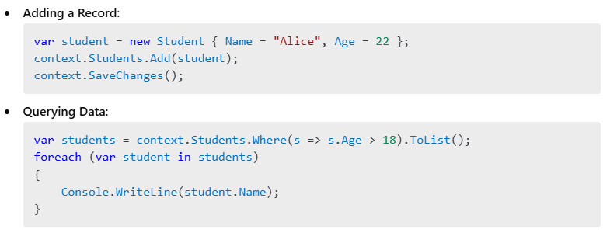
Example 2: Using Entity Framework Core

Slide 17
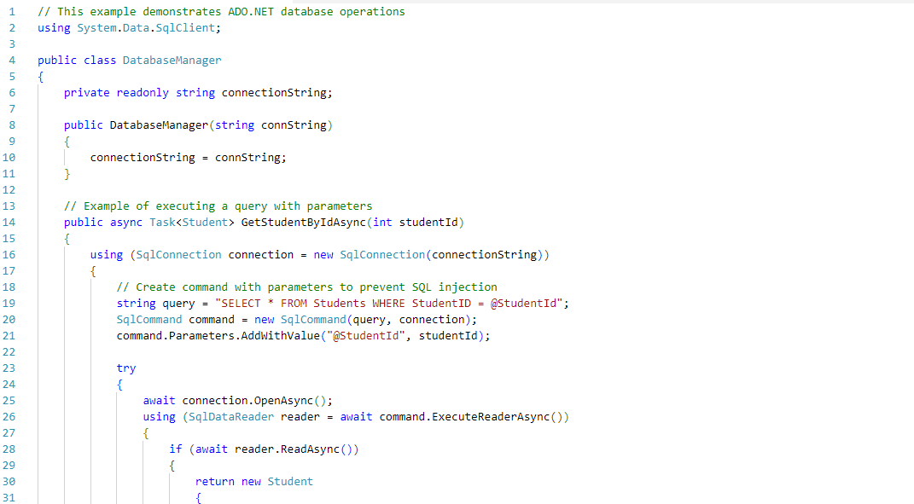
Example 3: ADO.NET Implementation

Slide 18
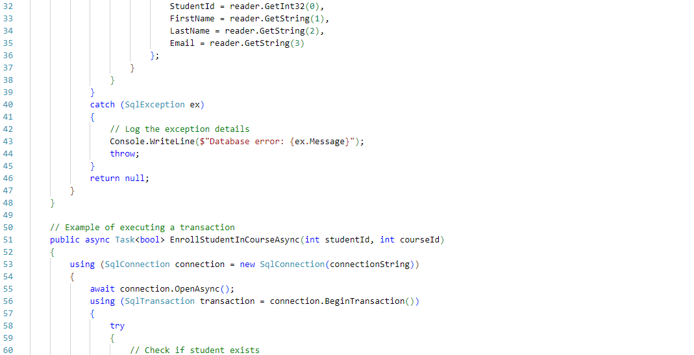
Example 3: ADO.NET Implementation

Slide 19
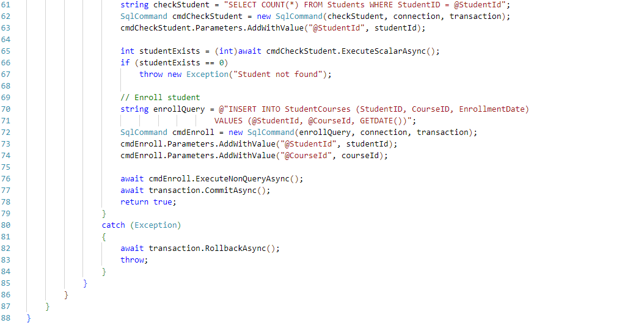
Example 3: ADO.NET Implementation

Slide 20
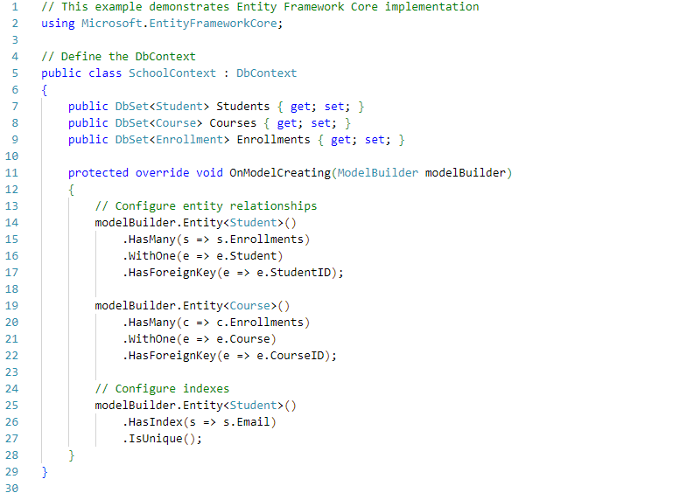
Example 4: Entity Framework Core Implementation

Slide 21
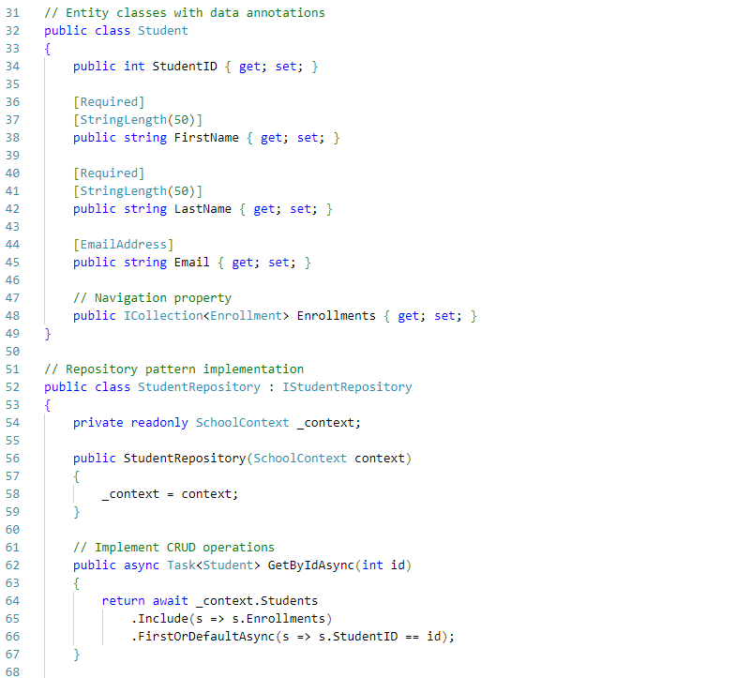
Example 4: Entity Framework Core Implementation

Slide 22
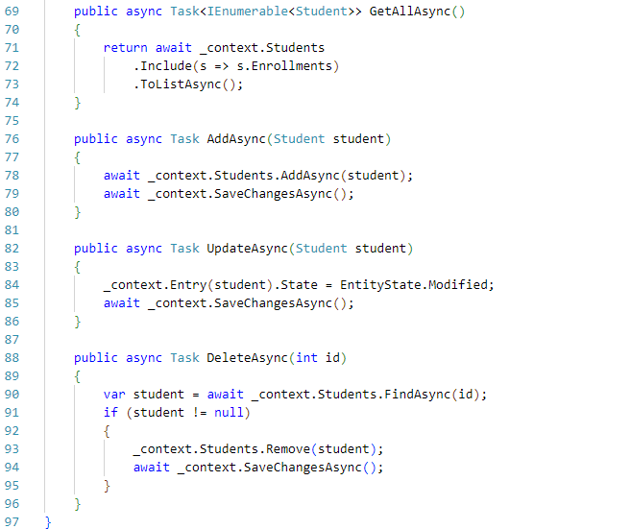
Example 4: Entity Framework Core Implementation

Slide 23
Summary and Q&A
Database Connectivity: ADO.NET patterns and best practices.
ORM with EF Core: Code-first and database-first approaches, LINQ, and performance tips.
Practical Demonstrations: CRUD operations in ADO.NET and EF Core.

Slide 24
Discussion Questions:
How does connection pooling impact performance?
What are the advantages of using EF Core over ADO.NET?

Slide 25
Practice Exercises

Slide 26
1. Database Connection Management
Implement a connection pool manager
Create a generic repository pattern
Handle database exceptions properly

Slide 27
2. Entity Framework Implementation
Create a complete CRUD application
Implement complex queries using LINQ
Add proper validation and error handling

Slide 28
Further Reading
Books:
  "Pro C# 10 with .NET 6" by Andrew Troelsen and Philip Japikse
  "Entity Framework Core in Action" by Jon P. Smith
  "Programming Microsoft ADO.NET 4" by David Sceppa
Online Resources:
  Microsoft Learn: ADO.NET Overview
  Microsoft Learn: Entity Framework Core
  Entity Framework Core Documentation
Tutorials:
  TutorialsPoint: ADO.NET Tutorial
  CodeMaze: EF Core Tutorials
Community Forums:
  Stack Overflow
  Reddit: r/dotnet
Tools and References:
  SQL Server Management Studio (SSMS)
  LINQPad for testing LINQ queries

Slide 29
Next Week
Week 7: Debugging and Testing Software

